Slide 1
Reproducible workflows with AiiDA
The power and challenges of full data provenance
Marnik Bercx, Julian Geiger, and Xing Wang
EnhanceR Symposium 2024, Empa Dübendorf, 07 Nov 2024

Slide 2

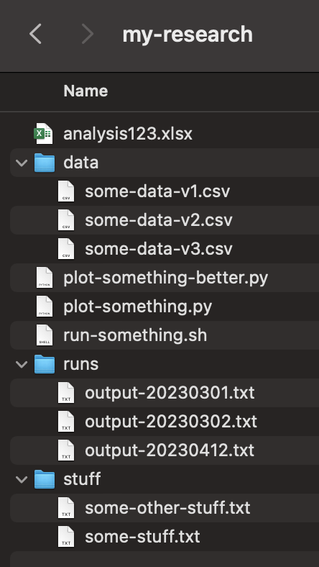
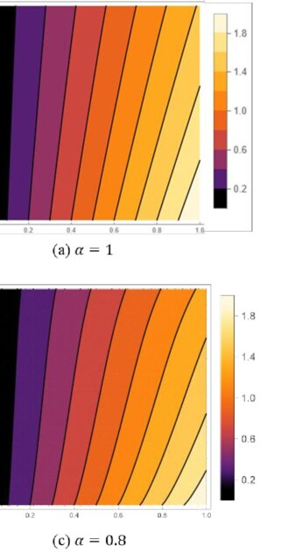
Has this ever happened to you?
?
Notes:
When it comes to scientific research, let me start by asking: has this ever happened to you? [Pause briefly for effect.]
You’re working hard on your research, juggling lots of files, scripts, and data. You think everything is in place, but when it’s time to redo or build on your work, you feel lost and frustrated. Does that sound familiar?
This situation is common in computational science. Messy workflows and poor documentation can waste a lot of time and lead to lost results. But it’s not just a personal headache—it also affects the reliability and reproducibility of scientific research.

Slide 3
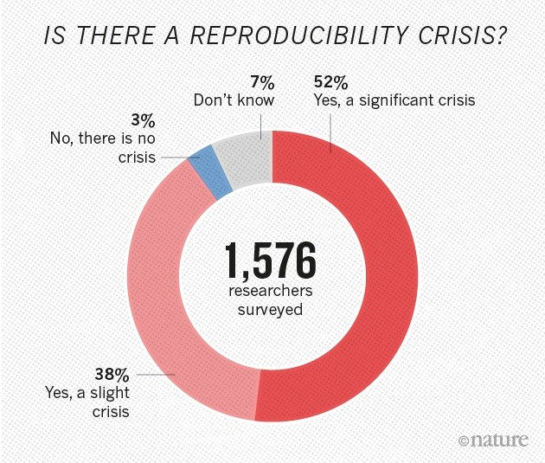
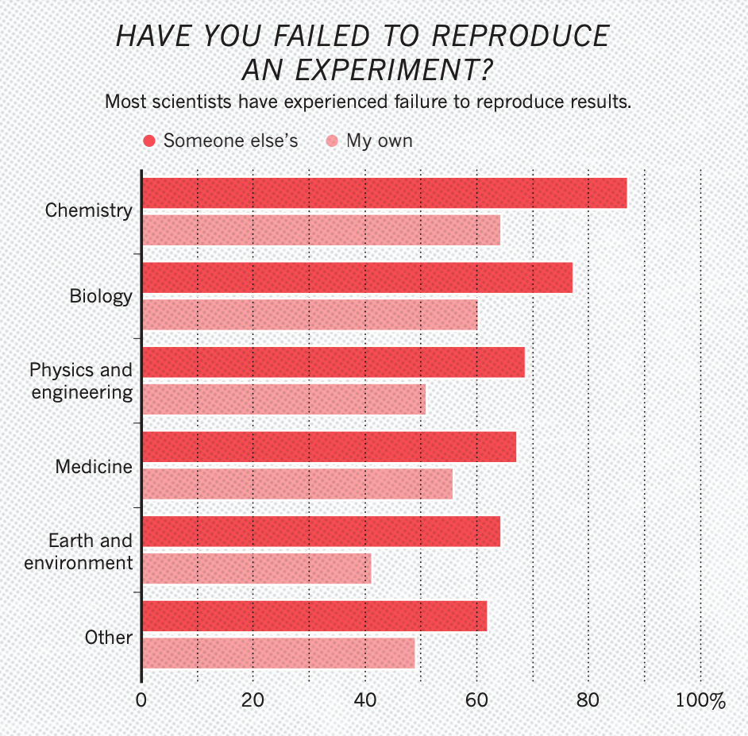
Reproducibility
In experimental science, this may be understandable…
No excuses in computational science. We must be fully reproducible. Challenge is to make open and reproducible science easier.
Monya B., Nature 533, 452–454 (2016)
Notes:
Reproducibility is a cornerstone of scientific integrity. However, as we see in this study published in Nature, more than half of the scientists surveyed believe that there is a significant reproducibility crisis in science today. Only 3% of respondents think there’s no crisis at all.
The challenges are especially clear when we look at the rates of failed reproduction attempts across different fields. Whether it's chemistry, earth sciences, or any other discipline, the inability to reproduce both our own and others’ experiments is a serious concern.
In experimental science, there are often justifiable reasons why exact reproduction might be difficult—variability in conditions, materials, or even human error. However, in computational science, where everything can be controlled, we have no excuses. Our work should be fully reproducible.
Yet, the challenge remains: how do we make open and reproducible science easier?

Slide 4

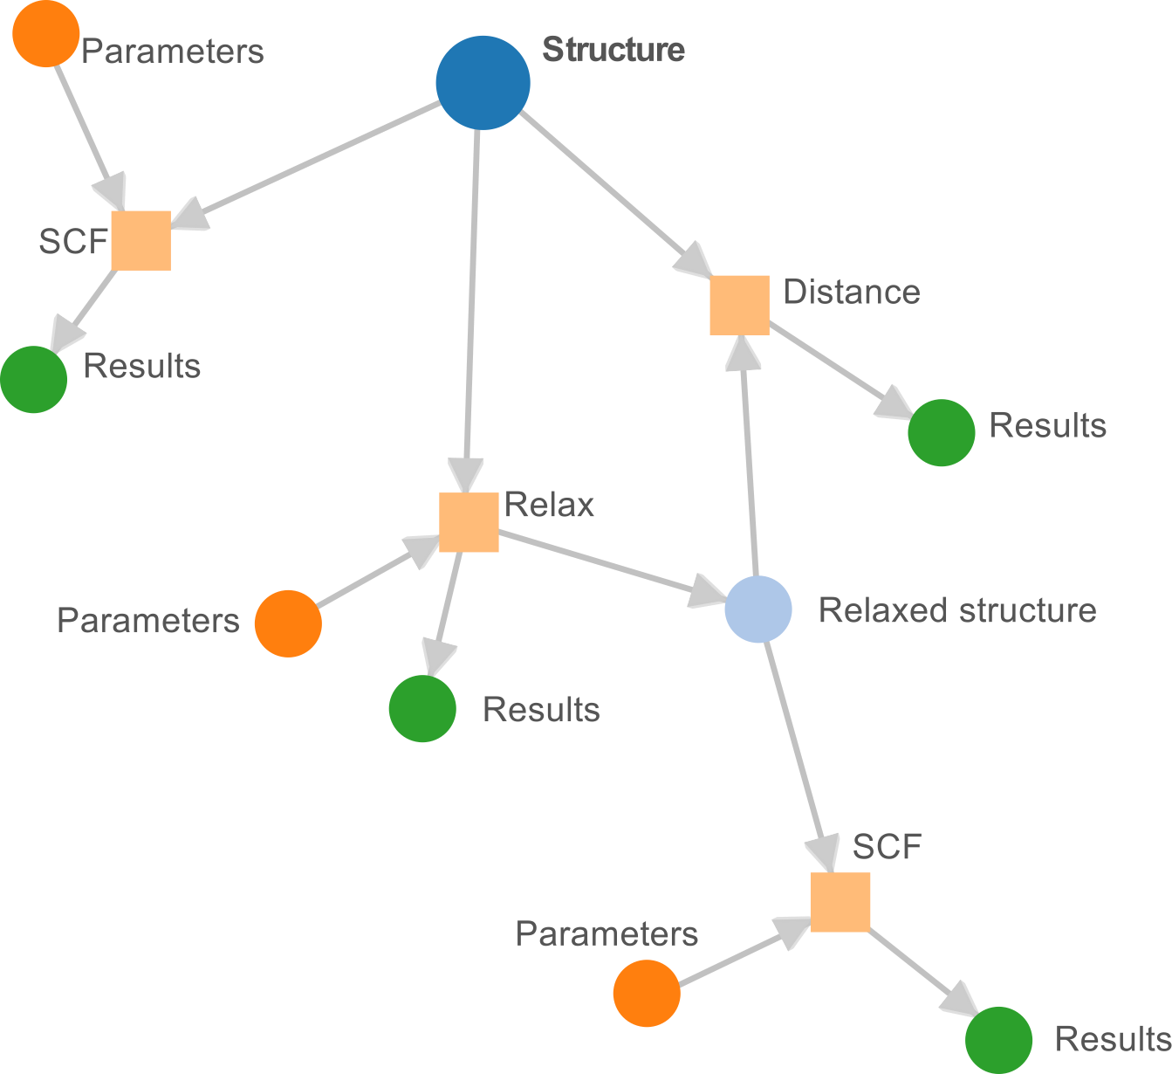

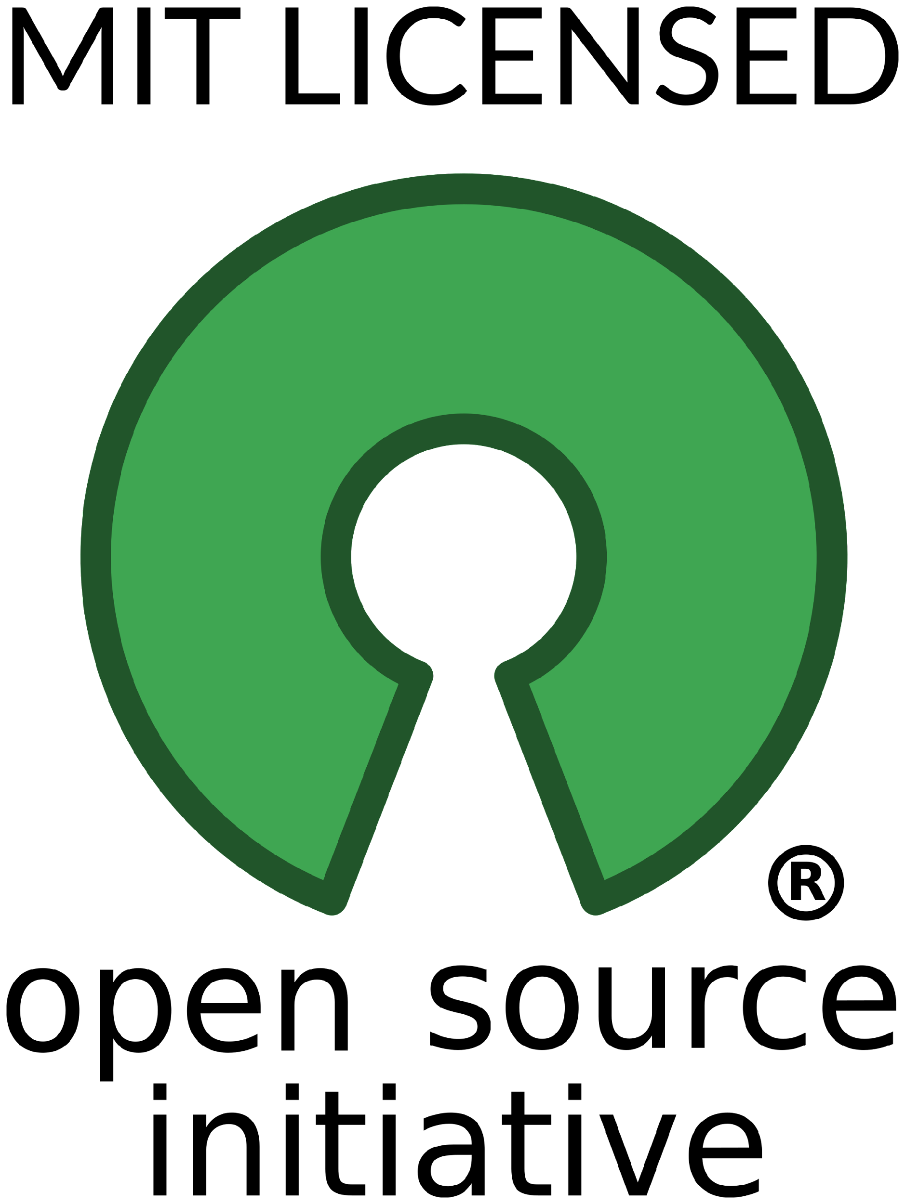





COMPUTATIONAL SCIENCE INFRASTRUCTURE
FOR HIGH THROUGHPUT WORKFLOWS
WITH FULL DATA PROVENANCE
Language: implemented and API in python
License: MIT open source http://www.aiida.net/
Source: https://github.com/aiidateam/aiida-core
Scalable workflow engine
Built-in support for HPC
Automated full data provenance
Flexible plugin system

Slide 5
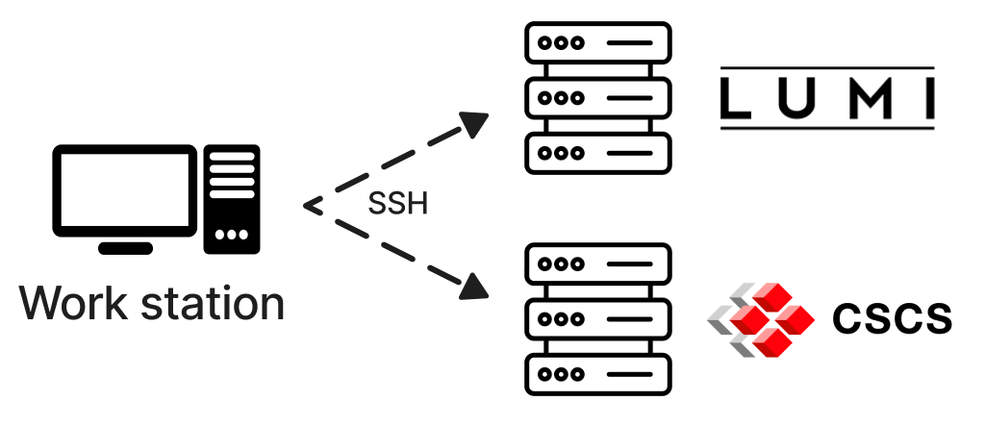

Built-in support for HPC
Support for common schedulers
Slurm
PBS/Torque
SGE
…
What if connection fails?
Try again for 5 times with EBM
Pause process
Advantages
Easy to understand and set up
Nothing installed on cluster
Easy to run on multiple systems
But won't that lead to too many connections?
Tasks that require SSH are grouped
"safe interval" is configurable
Disadvantages
You have to set it up yourself
Multi-factor authentication
Notes:
AiiDA provides built-in support for HPC, and it connect your local workstation to HPC resources like LUMI and CSCS through secure SSH connections. This allows you to seamlessly submit and manage your computational tasks on powerful supercomputers directly from your AiiDA environment.
The advantages here are clear: easy setup, no installation of extra software on the cluster, and the ability to run on multiple systems. Of course, there are a few downsides, such as the need for manual setup and dealing with multi-factor authentication, but these are minor compared to the benefits."

Slide 6
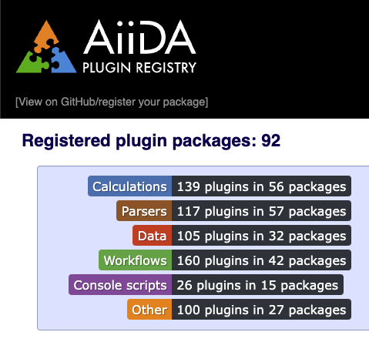

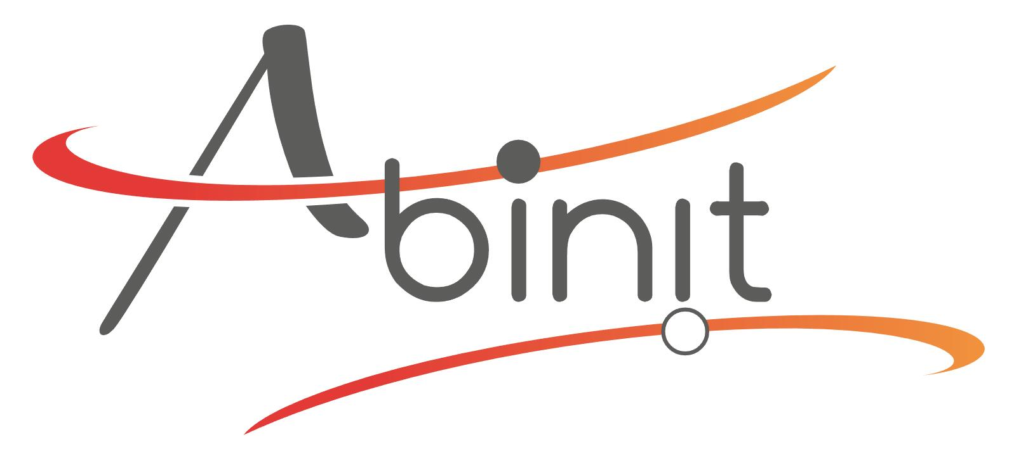
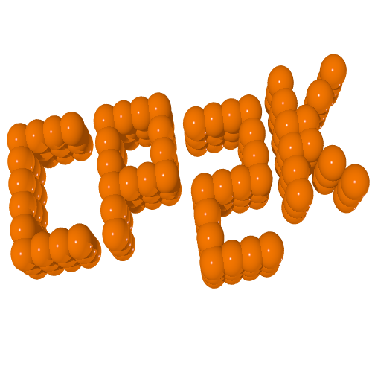
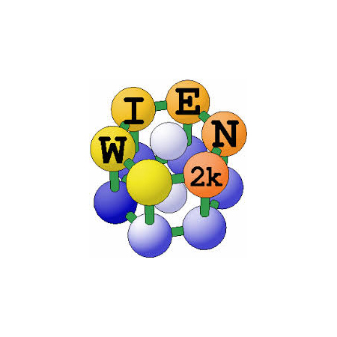
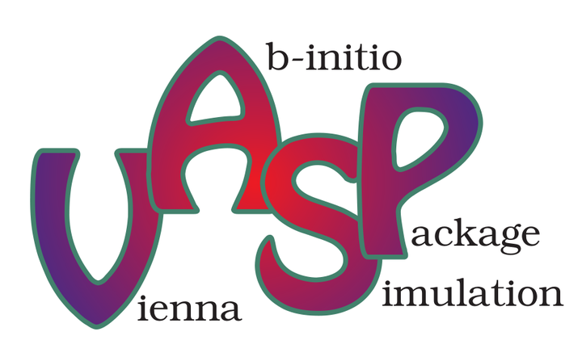

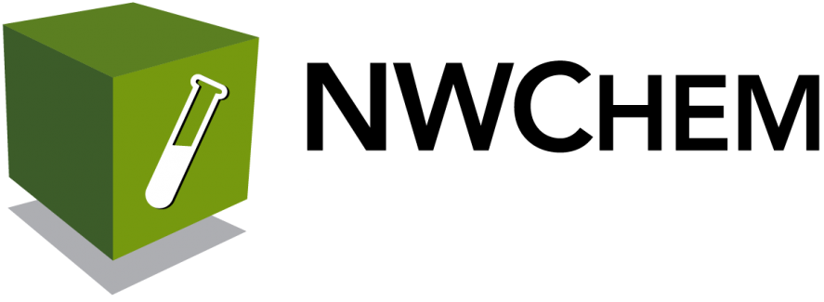

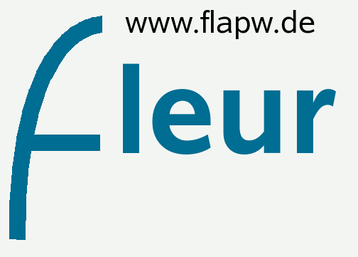
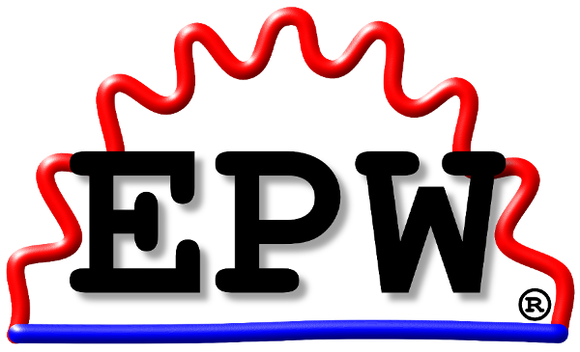
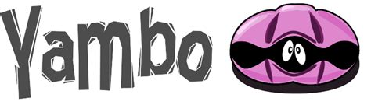
Flexible plugin system
Support for many materials science codes
https://aiidateam.github.io/aiida-registry/
…
Notes:
AiiDA allows you to extend its capabilities according to your research needs. As of now, the AiiDA plugin registry boasts 92 registered plugin packages, including those for calculations, parsers, data management, workflows, and console scripts.
This robust plugin system supports a wide range of materials science codes, including popular ones like Quantum ESPRESSO, VASP, CP2K, and NWChem, to name a few. Each of these plugins is designed to interface with AiiDA, enabling you to manage complex workflows seamlessly.
The flexibility of AiiDA’s plugin system means that you can adapt the software to suit your specific research needs, and also meaning you can contribute your own plugins or benefit from those shared by others.

Slide 7
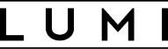
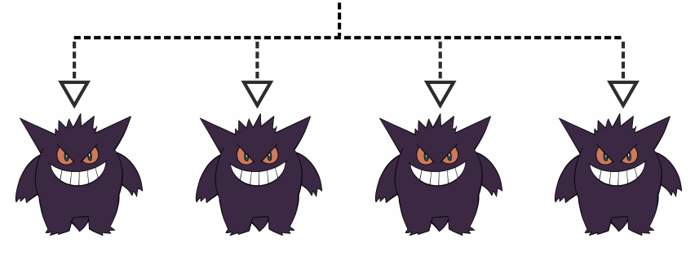
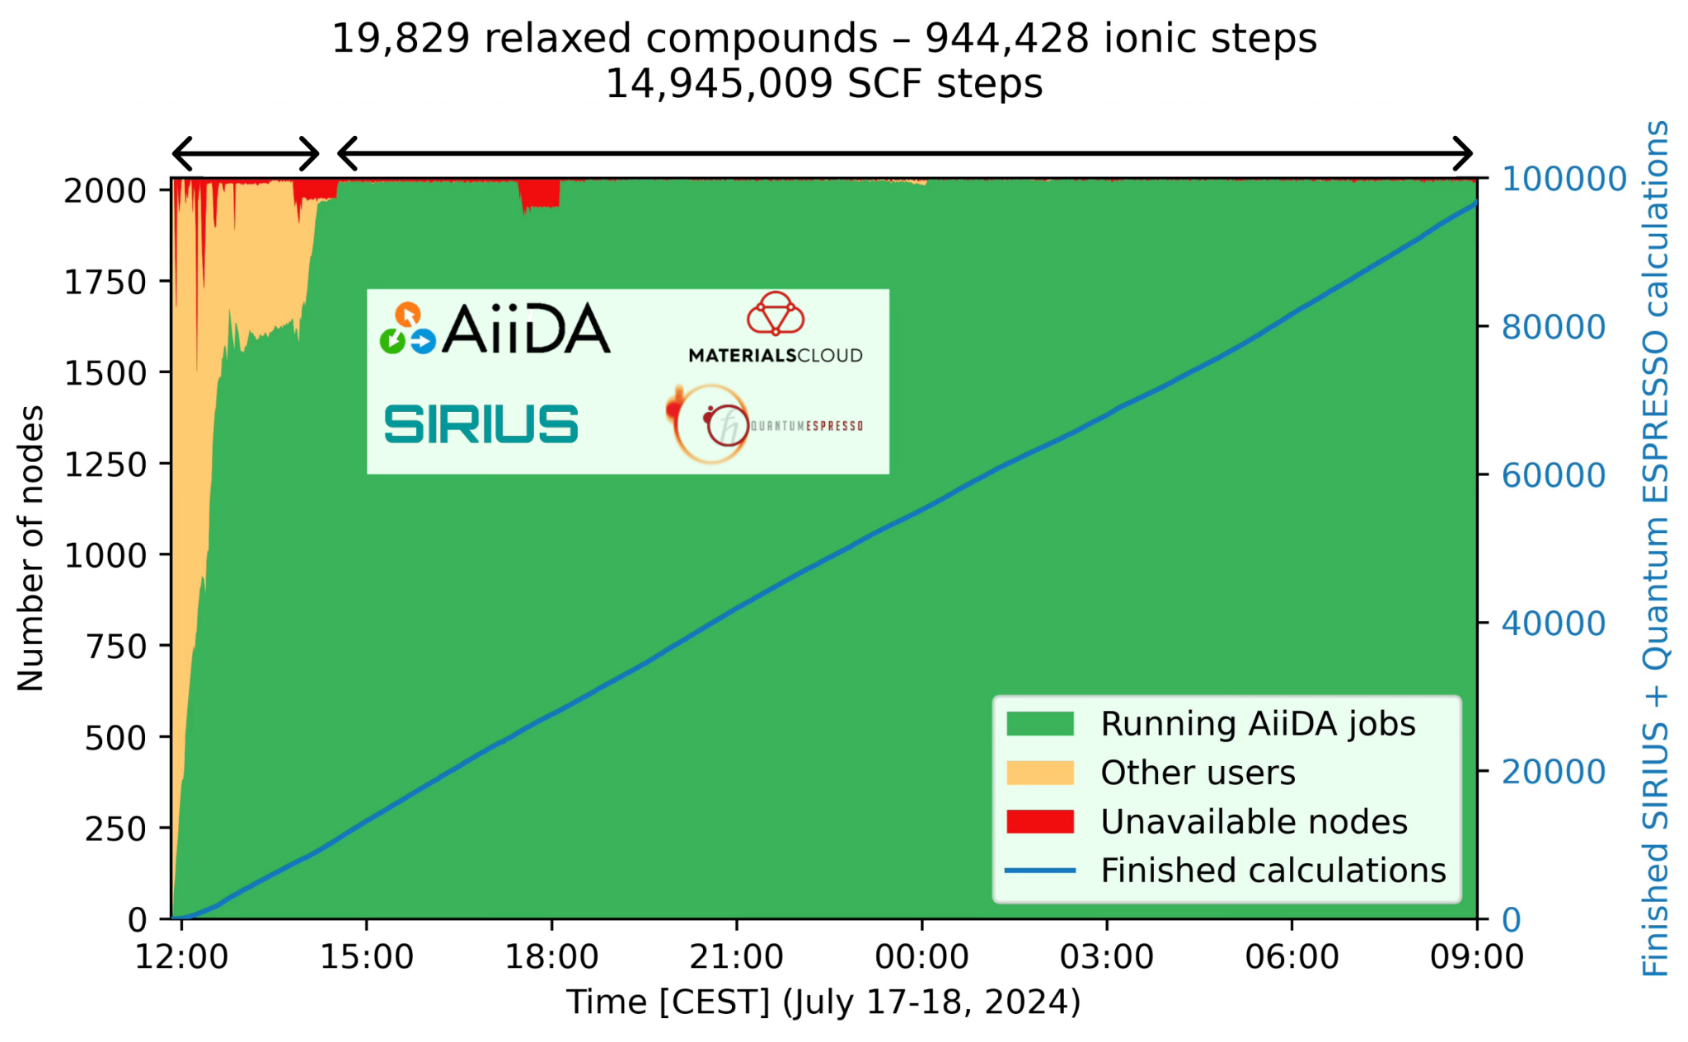
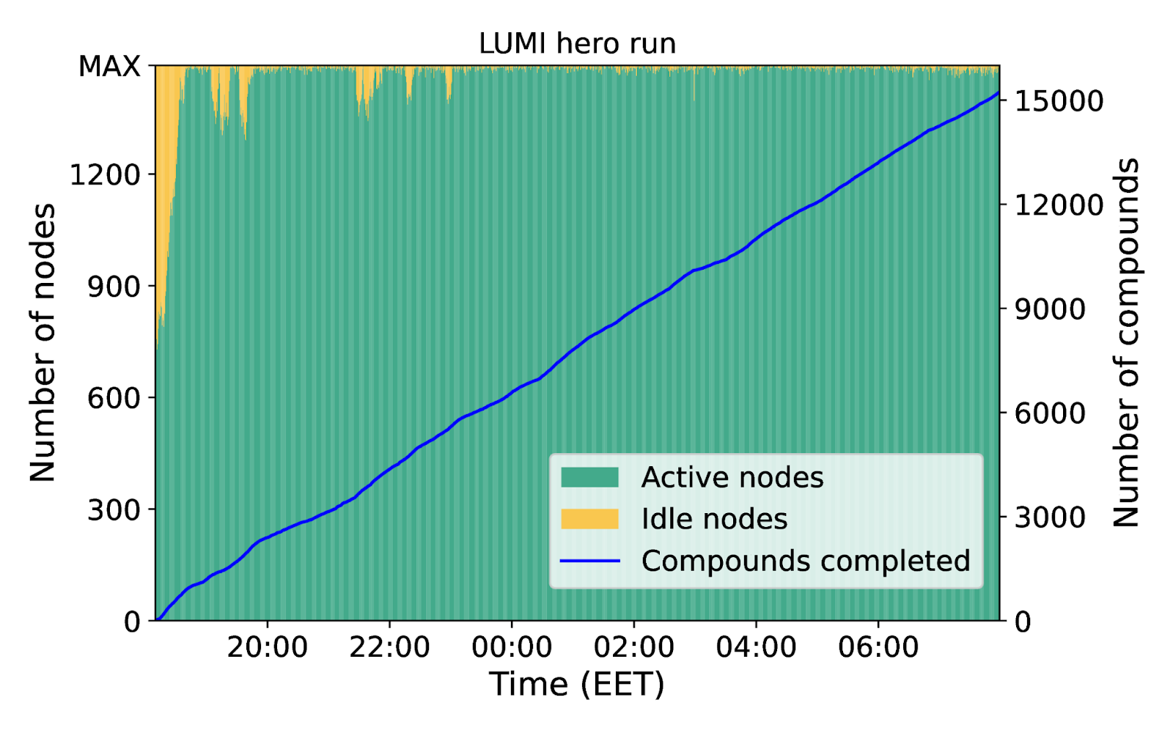
Scalable workflow engine
Ran 55704 Quantum ESPRESSO calculations in 12 hours
Handled 7887 errors on the fly
Fully optimized 15324 geometries
Using 192k CPU cores
AiiDA "workers"
AiiDA workers take care of everything
Upload inputs
Submit to scheduler
Monitor queue
Retrieve outputs
Parse
Notes:
AiiDA’s workflow engine is designed to scale with your research. Whether you’re managing a few small jobs or tens of thousands of calculations, AiiDA handles everything efficiently.
Here, you can see how AiiDA interacts with a system like LUMI, deploying 'workers' that take care of each step in your workflow. These workers manage tasks like uploading inputs, submitting jobs to the scheduler, monitoring the job queue, retrieving outputs, and parsing the results—all without requiring manual intervention.
To give you a sense of the scale, during one of our hero runs on LUMI, AiiDA managed 55,704 Quantum ESPRESSO calculations in just 12 hours. It automatically handled 7,887 errors and fully optimized 15,324 geometries. This level of automation and scalability is what makes AiiDA an invaluable tool for high-throughput computational research.

Slide 8
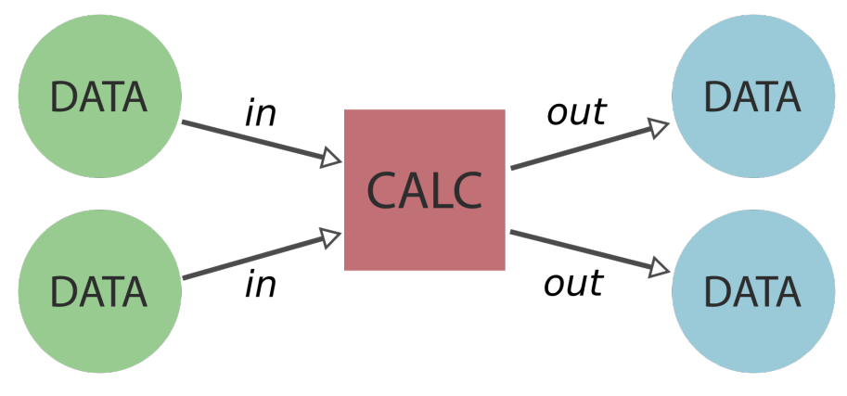
Data Provenance
Simple recipe
Store data transformations or "calculations".
Store its inputs and outputs.
Most crucially: store the inter-connections or "links".
Provenance graphs
When data is reused, a directed acyclic graph is created.
Quickly grows in complexity even for "simple" workflows
Notes:
AiiDA’s approach to data provenance ensures that every step of your computational workflow is traceable. The idea is simple: store data transformations or 'calculations,' along with their inputs, outputs, and the inter-connections between them, which we refer to as 'links.'
These interconnections create provenance graphs, which visually represent how data flows through your workflow. As data is reused and processes become more complex, these graphs grow in complexity, but they also provide an invaluable resource for understanding and reproducing your results.

Slide 9
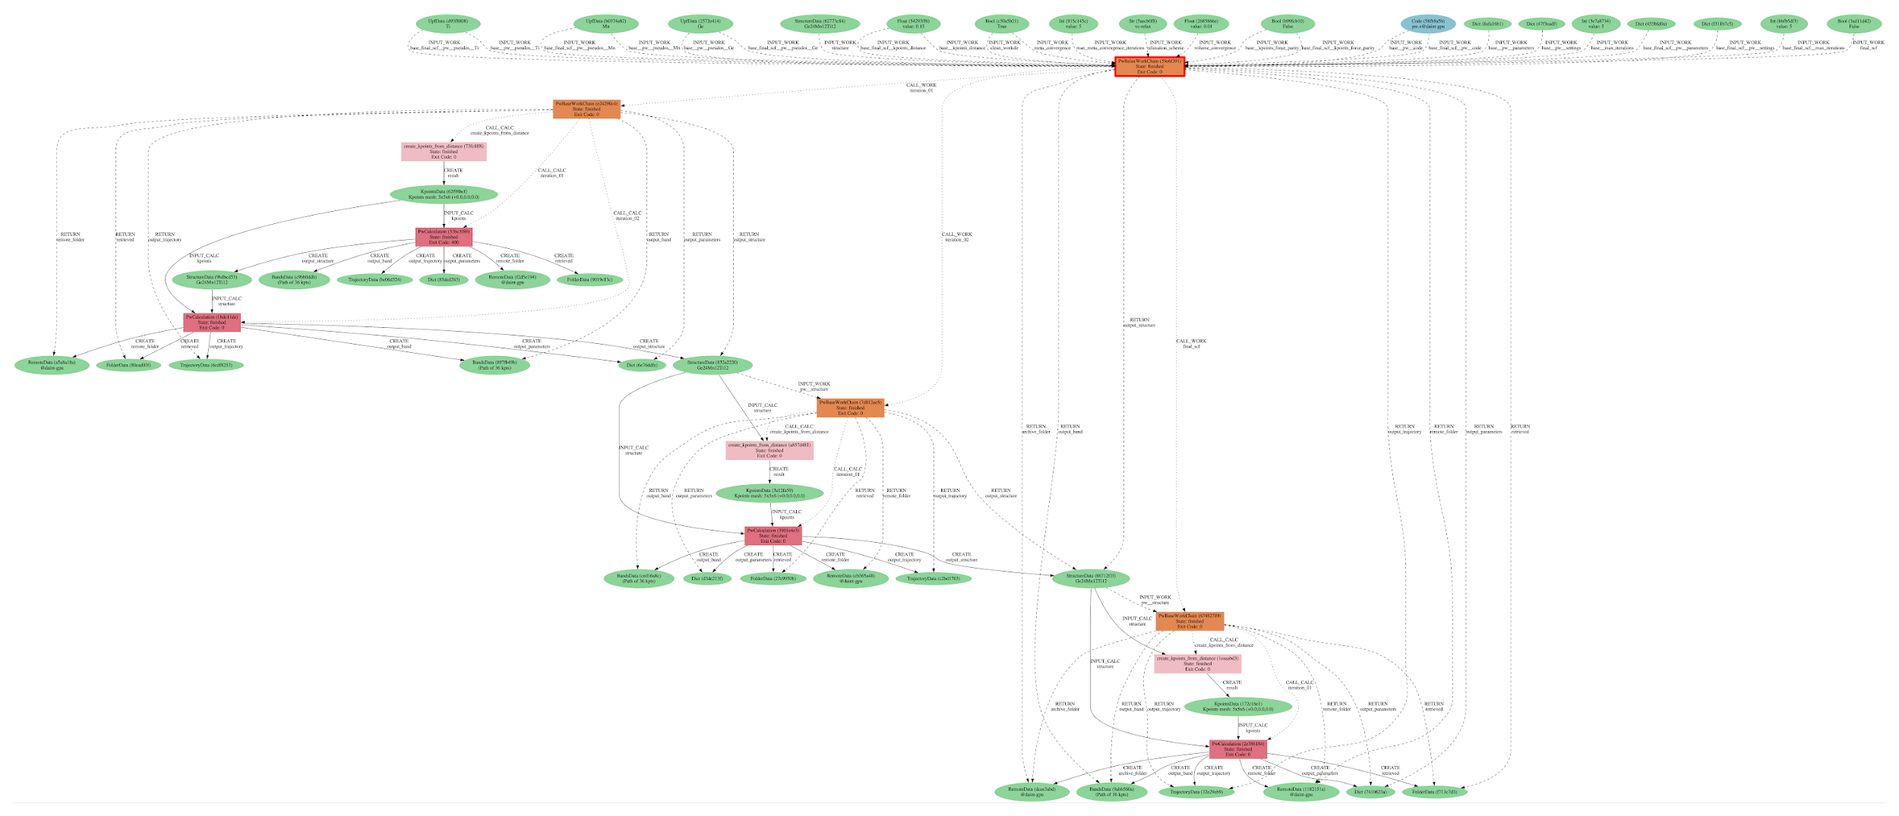
Data Provenance
Geometry optimization workflow
Notes:
This slide illustrates a real-world example of a geometry optimization workflow, visualized through a provenance graph. Each node represents a piece of data or a process, and the connections between them show how data flows from one stage to the next.
In this example, you can see how complex the graph can become, even for a relatively straightforward workflow like geometry optimization.

Slide 10
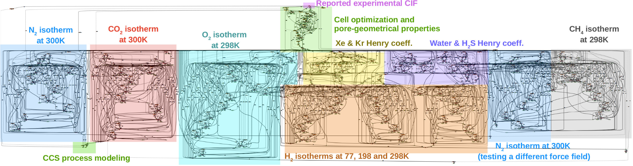
Data Provenance
Screening of the adsorption properties of nanoporous materials
D. Ongari et al, ACS Cent. Sci. 2020, 6, 11, 1890–1900
Notes:
Here’s another example of data provenance in action, this is from a paper which calculate the adsorption properties of nanoporous materials. As you can see, the graph includes a wide range of calculations, including isotherms for different gases at various temperatures, cell optimizations, pore geometrical properties, and more. Each section of the graph corresponds to a specific part of the workflow, showing how data from one step informs the next.
This level of detail is invaluable for complex studies like this, where understanding the provenance of each data point is crucial for ensuring the accuracy and reproducibility of the results.
However, this complexity is precisely what makes AiiDA so powerful—it captures every detail of the workflow, ensuring that anyone can follow and reproduce the results.

Slide 11
Data Provenance - Ups and Downs
Upsides
Downsides
Reproducibility
Enforced organisation
Easy to clean up/share data
Powerful querying
Interactive exploration
Caching becomes easy and fast
Every piece of data must be a “Node”.
Every process needs a node-based interface.
Once stored, nodes are immutable.
Keeping provenance in workflows introduces extra overhead.
You need a database
Notes:
While AiiDA’s data provenance system offers many advantages, it’s important to acknowledge the trade-offs as well. On the upside, data provenance ensures reproducibility, enforces organization, and makes it easier to clean up and share data. It also enables powerful querying capabilities, interactive exploration, and efficient caching.
However, there are some downsides to consider. Every piece of data must be a node, and every process needs a node-based interface. Once stored, nodes become immutable, which can add overhead if you need to modify them later. Additionally, keeping detailed provenance can introduce extra computational and storage overhead, and you’ll need an database to manage everything.

Slide 12
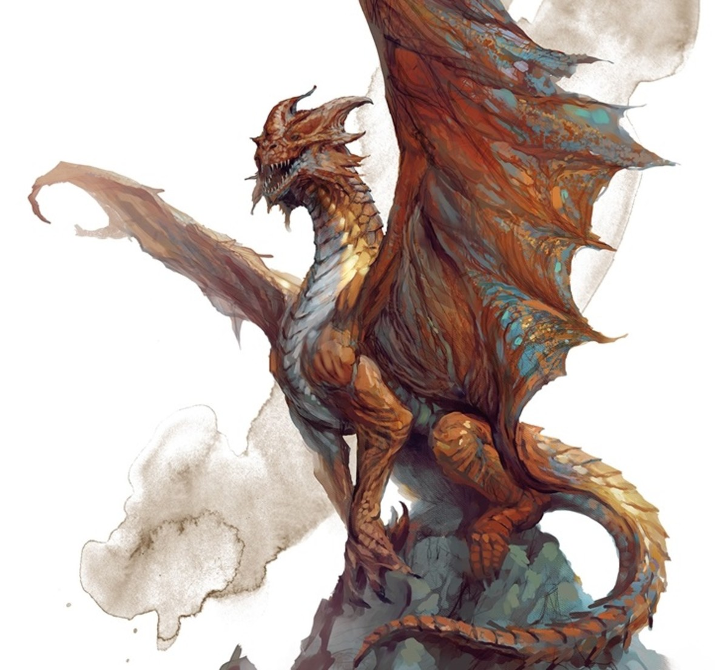
“AiiDA is powerful, but complex…”
Installation and setup was long and cumbersome.
Running external codes requires building an interface.
Writing workflows required the development of a full plugin package.
How can we make AiiDA more accessible to new users (with modest Python knowledge)?
Notes:
AiiDA is powerful, but also complex. For many new users, the initial setup and installation can be a bit difficult, especially given the need to build interfaces for running external codes. Writing workflows also requires developing full plugin packages, which can be challenging without a strong background in Python.
How can we make AiiDA more accessible to new users, particularly those with modest Python knowledge? This is a challenge we’re actively working to address, now let’s give a several latest updates on AiiDA.

Slide 13
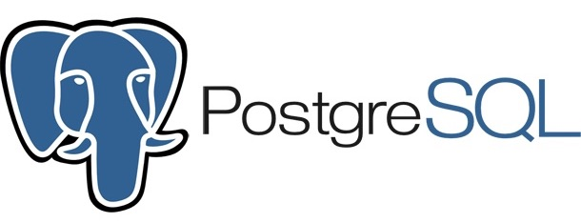
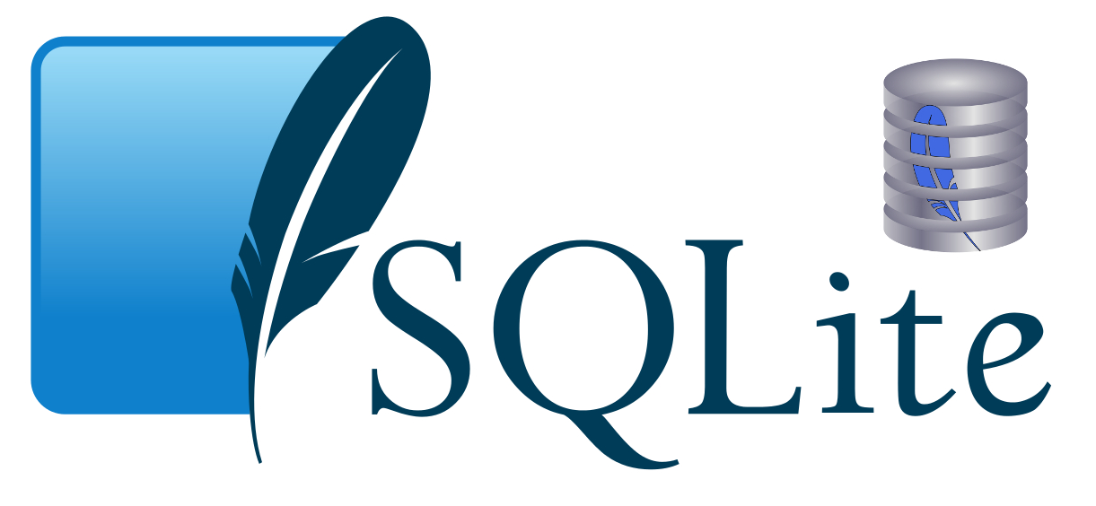
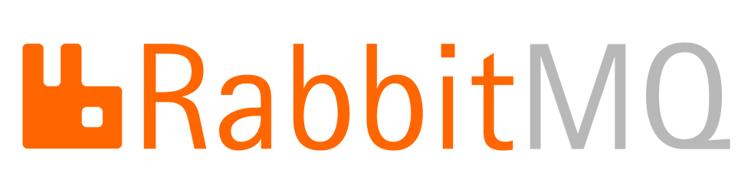
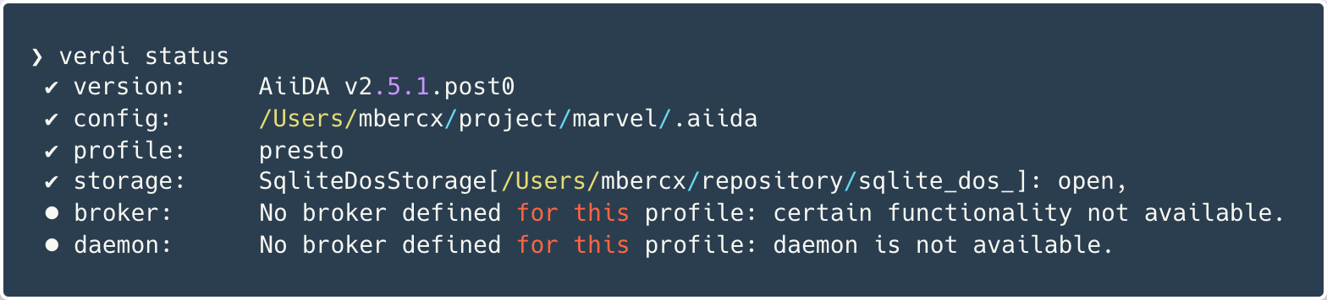
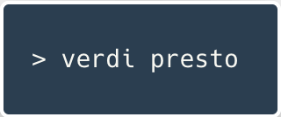
Serviceless install
After v2.6.1 AiiDA:
Database:
Offer more storage options, e.g.
Engine:
Allow running without RabbitMQ
Now you can set up a profile in a jiffy!
Notes:
We’ve introduced a new feature that simplifies the installation process. With the latest updates, AiiDA now offers more storage options, such as SQLite, and allows running without RabbitMQ. This 'serviceless' setup means you can now set up a profile in a jiffy using the 'verdi presto' command, which makes it easier to get started with AiiDA.
This is very helpful for the new user who want to learn AiiDA, but later they can switch to PostgreSQL and RabbitMQ for production calculation.

Slide 14

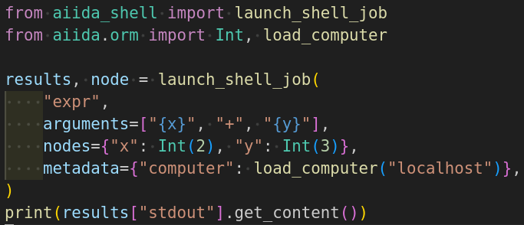
Simple running of an executable through AiiDA
aiida-shell:
Run any executable through AiiDA without plugin
Easy porting of existing (e.g. bash or python) scripts
Custom parser function can be attached to parse output files
Dr. Sebastiaan Huber
For example, run a simple addition (1+2) using “expr” command
You can specify an HPC here.

Slide 15
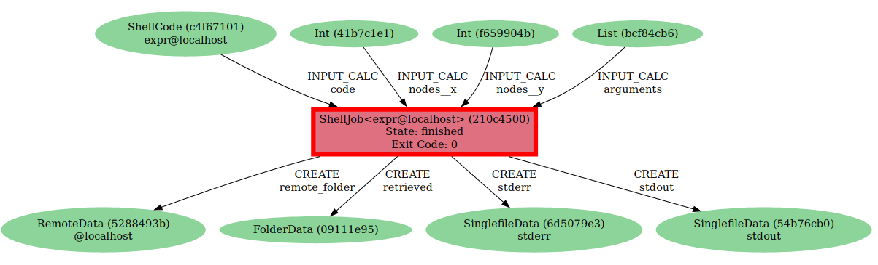
Data provenance of a ShellJob
Notes:
For developers unfamiliar with the Python (i.e., classmethod, super())

Slide 16
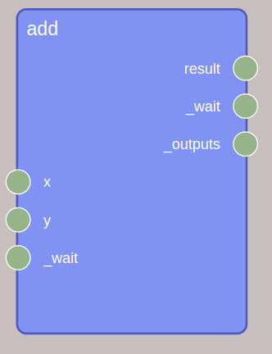
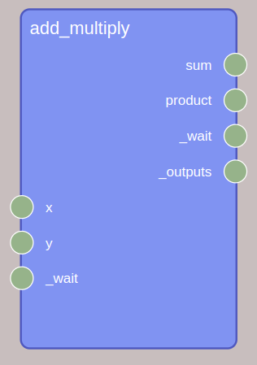
Simplify workflow creation: WorkGraph
A task has inputs, outputs, and a executor
The default name of the output socket is result. You can define the output sockets explicitly.
@task()
def add(x, y):
return x + y
@task(
outputs=[{"name": "sum"}, {"name": "product"}]
)
def add_multiply(x, y):
return {"sum": x + y, "product": x * y}
Notes:
For developers unfamiliar with the Python (i.e., classmethod, super())

Slide 17
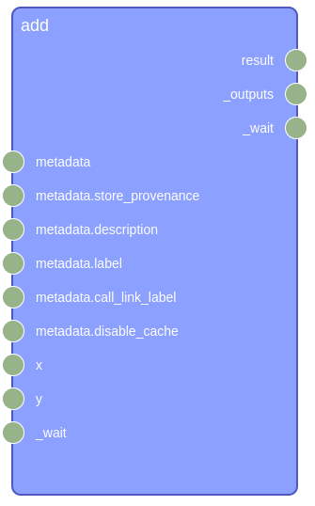
Concepts: task with provenance
All AiiDA process components can be used as a task
calcfunction
workfunction
calcjob
workchain
@task.calcfunction()
def add(x, y):
return x + y
Notes:
For developers unfamiliar with the Python (i.e., classmethod, super())

Slide 18
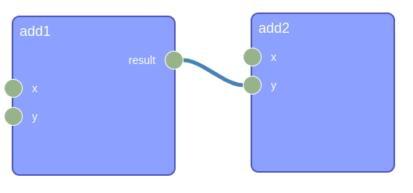
Concepts: WorkGraph
A collection of tasks and links.
from aiida_workgraph import WorkGraph
@task.calcfunction()
def multiply(x, y):
return x * y
wg = WorkGraph("Test_WorkGraph")
task1 = wg.add_task(multiply, x=1, y=2)
task2 = wg.add_task(multiply, x=1, y=task1.outputs["result"])
Notes:
Now, let’s use the task to create a workflow. In AiiDA, we call the workflow WorkGraph. A workgraph is a collection of tasks and links

Slide 19
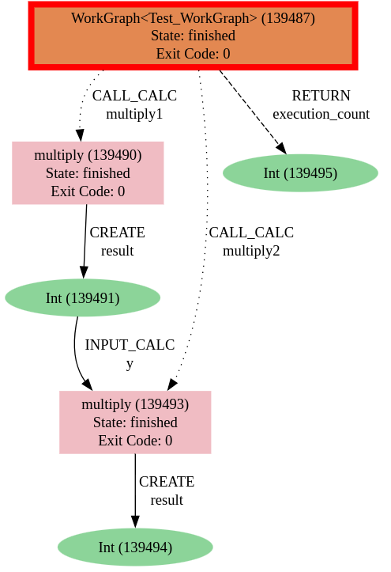
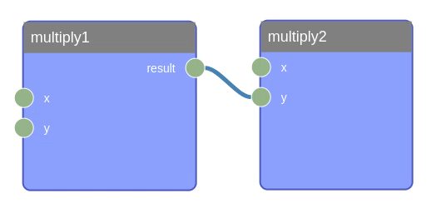
Concepts: provenance
Notes:
For developers unfamiliar with the Python (i.e., classmethod, super())

Slide 20
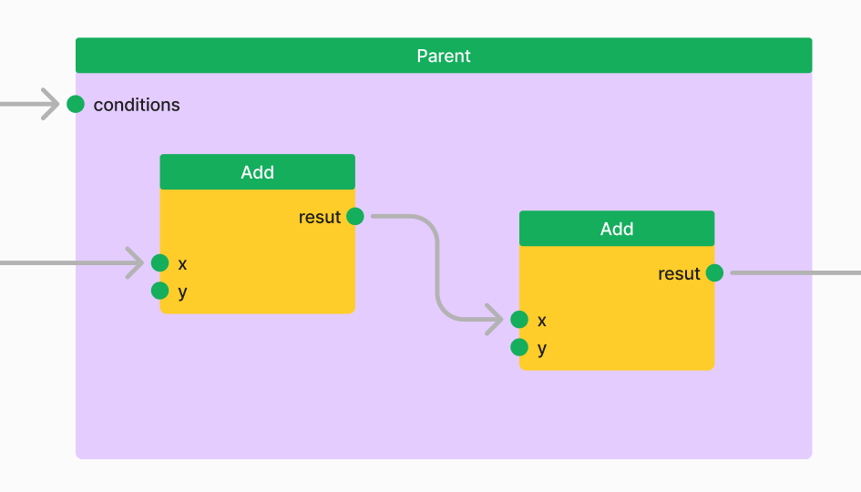
Concepts: Zone for flow control
zone: Group tasks for execution
if zone: only execute the tasks if input conditions are True
while zone: the tasks will keep running as long as the condition remain True
Notes:
For developers unfamiliar with the Python (i.e., classmethod, super())

Slide 21
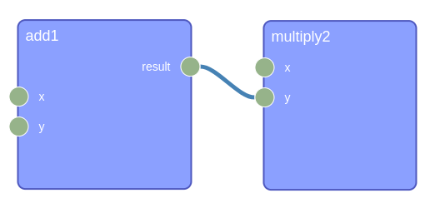
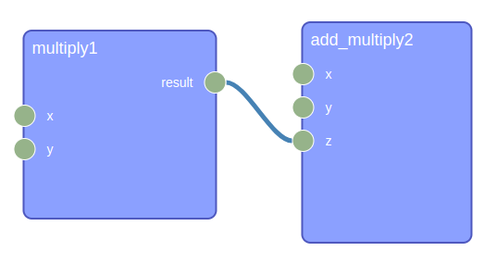
Concepts: nested workgraph
A WorkGraph can also be a task, thus we create nested workflow
Create a sub-graph on-the-fly using graph_bulder task. For example, if condition
Notes:
For developers unfamiliar with the Python (i.e., classmethod, super())

Slide 22
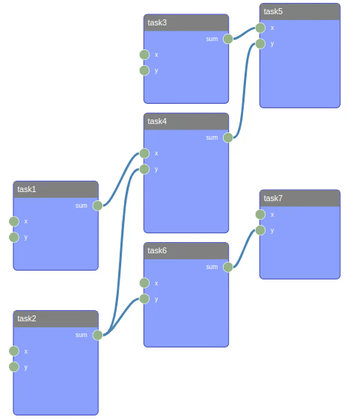
Concepts: Engine
Dependency-based Execution
No input task
All input tasks are finished
The parent task is running
Save checkpoint for each step
Checkpoint is important for long running workflow, e.g., a quantum chemistry calculation may take few days or weeks.
Notes:
Which means you can run tasks in parallel as long as you have enough daemon worker to pick up the task.

Slide 23
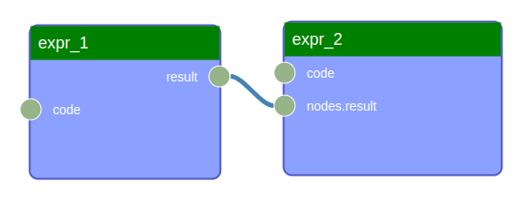
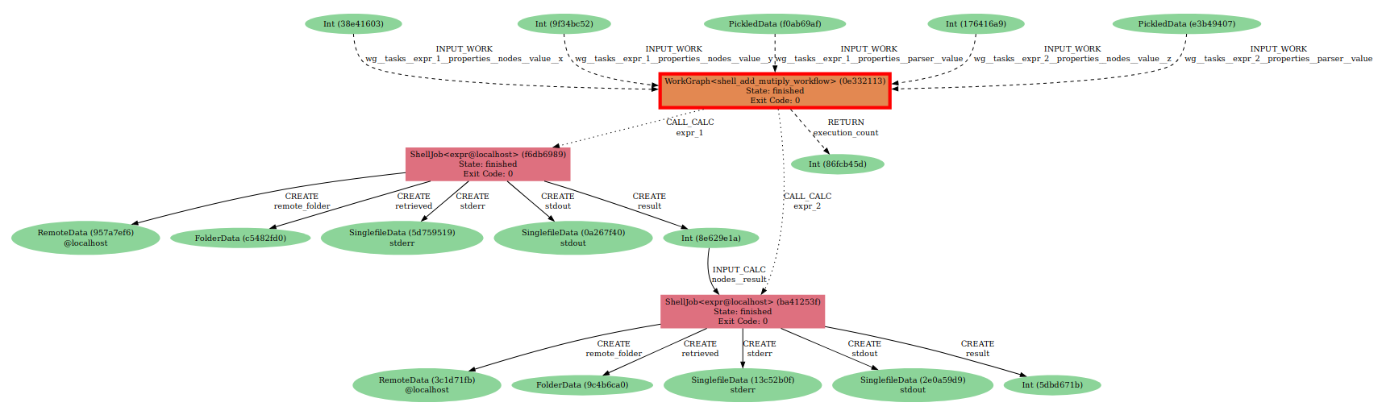
Using the aiida-shell inside WorkGraph
wg = WorkGraph(name="shell_add_mutiply_workflow")
expr_1 = wg.add_task("ShellJob", command="expr", arguments=["{x}", "+", "{y}"], nodes={"x": Int(2), "y": Int(3)})
expr_2 = …
Notes:
For developers unfamiliar with the Python (i.e., classmethod, super())

Slide 24
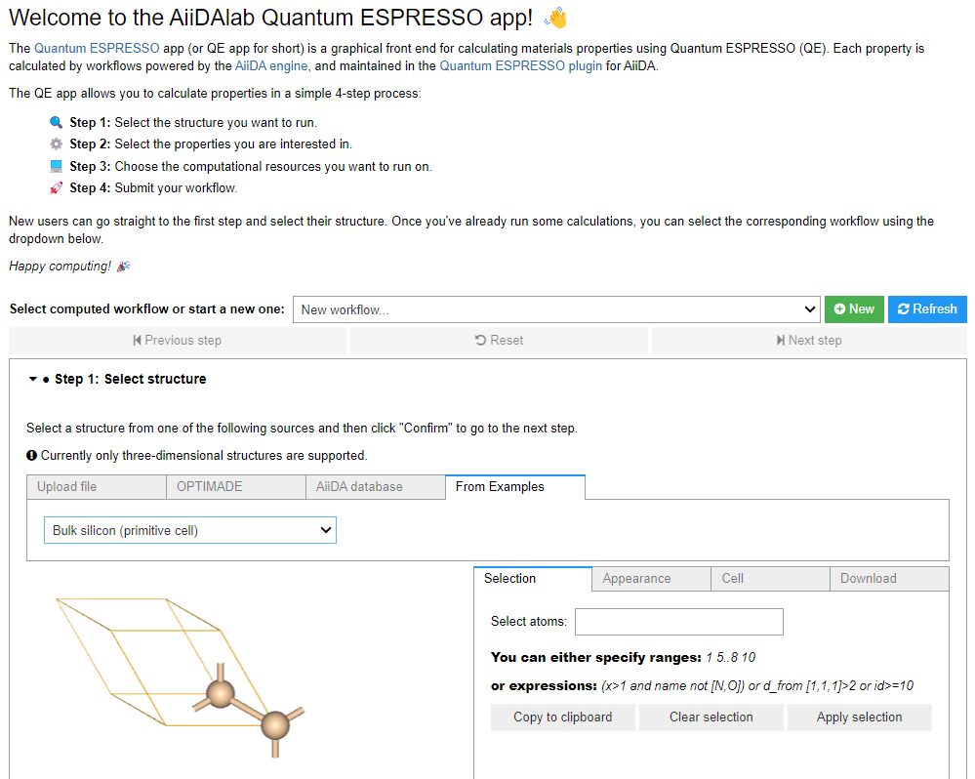
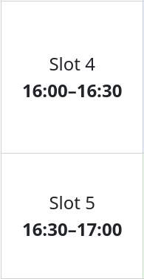
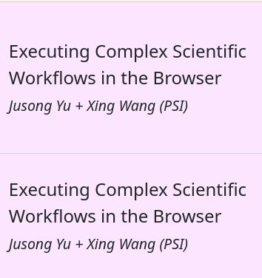
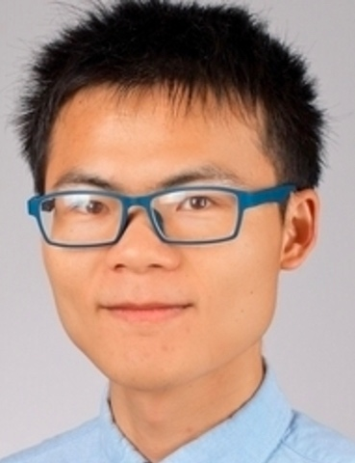
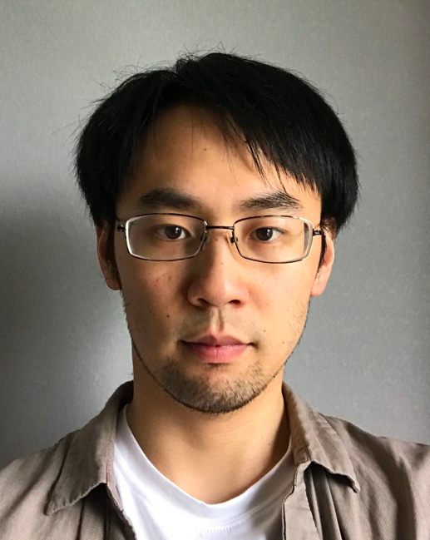
AiiDAlab: AiiDA online deployment
Show-and-tell live demo:
Xing
Wang
Jusong
Yu

Slide 25
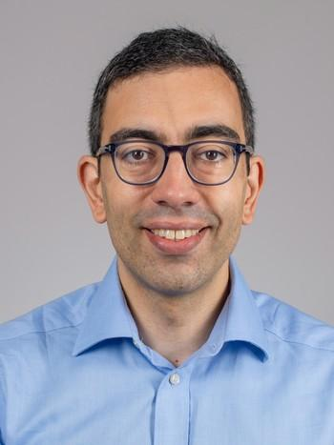
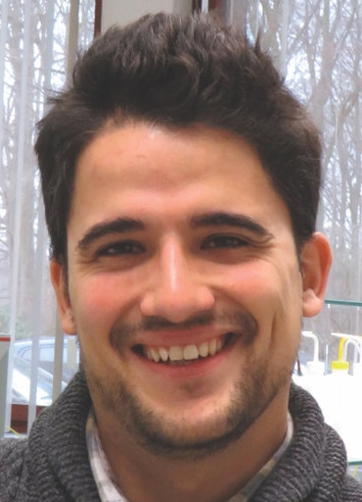




















Acknowledgements
People involved in AiiDA, AiiDAlab, and Materials Cloud
MSD team
Giovanni Pizzi
(PSI)
Marnik
Bercx
(PSI)
Miki Bonacci (PSI)
Edan
Bainglass
(PSI)
Xing
Wang
(PSI)
Jusong
Yu
(PSI)
Ali
Khosravi
(PSI)
Alexander
Goscinski
(PSI)
Michail Minotakis
(PSI)
Julian Geiger
(PSI)
Timo
Reents
(PSI)
Nataliya
Paulish
(PSI)
Nicola Marzari
(EPFL, PSI)
Sebastiaan P. Huber
(Microsoft)
Chris
Sewell
Francisco F. Ramirez
(EPFL)
Kristjan
Eimre
Daniel Hollas
(U. Bristol)
Leopold
Talirz
(Schott)
Aliaksandr
Yakutovich
(Empa)
Carlo Pignedoli (Empa)
Valeria Granata
(EPFL)
Joost
VandeVondele
(ETHZ,CSCS)
Thomas
Schulthess
(ETHZ,CSCS)
And all other former and present contributors who made these platforms what they are today:
Carl S. Adorf
Louis Ponet
Casper W. Andersen
Marco Borelli
Andrea Cepellotti
Edward Ditler
Rico Häuselmann
Fernando Gargiulo
Dominik Gresch
Conrad Johnston
Leonid Kahle
Snehal Kumbhar
Boris Kozinsky
Andrius Merkys
Nicolas Mounet
Tiziano Müller
Elsa Passaro
Daniele Passerone
Riccardo Sabatini
Ole Schütt
Berend Smit
Martin Uhrin
Spyros Zoupanos

Slide 26

Funding

